Slide 1
Digital Image Representation & Processing(2/2)
Lecture-3
S.P.Vimal
CSIS Group
BITS-Pilani
vimalsp@bits-pilani ac.in

Slide 2
To discuss…
Dithering
Image Formats
  GIF
  Other formats
11-Jan-07
Multimedia Computing (EA C473)

Slide 3
Dithering
Dithering is the attempt by a computer program to approximate a color from a mixture of other colors when the required color is not available
Commonly occurs when a display monitor attempts to display images specified with more colors than the monitor is equipped to handle.
To approximate an image with 256 intensity levels with 2 levels (ON/OFF), each pixel in the original image must be replaced be a larger pattern of ON/OFF, such that the pattern approximates the pixel intensity
11-Jan-07
Multimedia Computing (EA C473)

Slide 4
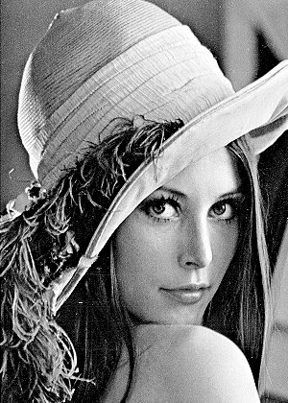
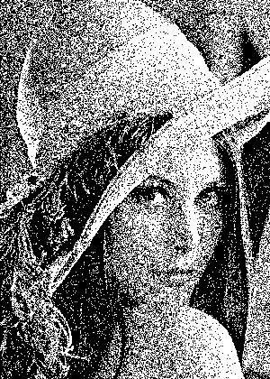
Dithering [2]
Random dithering
  Generate a random number from 0 to 255
  If it is greater than the pixel value at that point, plot the white pixel, else black pixel
  Repeat step 2 for each pixel in the image
It is useful in reproducing very low-frequency images
11-Jan-07
Multimedia Computing (EA C473)

Slide 5
Dithering [3]
We can instead use an n x n matrix of ON/OFF bits
Can represent n²+1 levels, the pattern is 0 1 3 2
Let the original image has 256 levels
  Re map it into n²+1 levels (0,1,2,3,4)
  If the remapped value is 0, print nothing
  If the remapped value is 4 print all dots
So the rule ?
  Print the corresponding dot in the dither matrix, if it’s value is lesser then the remapped pixel value. Each pixel is replaced by the n x n pattern.
11-Jan-07
Multimedia Computing (EA C473)

Slide 6

Dithering [4]
original image
Number of levels can be increased
If the pattern is 4 x 4 large, the image is 16 times larger.
Ordered dither algorithm overcomes this problem
(Result of Ordered dither)
11-Jan-07
Multimedia Computing (EA C473)

Slide 7
Dithering [5]
begin
for x=0 to x max
for y=0 to ymax
i=x mod n
j= y mod n
if I(x,y) > D(x,y)
O(x,y) = 1
else
O(x,y) = 0
end if
end for
end for
end
Ordered dither algorithm
  I(x,y) = input image
  D() = dither matrix
  O(x,y)= output image
11-Jan-07
Multimedia Computing (EA C473)

Slide 8
Image Formats - GIF
Stands for Graphics Interchange Format
The first graphic file type recognized by early web browsers
Originally developed by CompuServe, to distribute images across network
Available in two versions
  GIF87a
  GIF89a
11-Jan-07
Multimedia Computing (EA C473)

Slide 9
Image Formats – GIF Features[2]
LZW compression used is loss less compression. It is copyright protected. A new standard, PNG, is developed based on free compression algorithm.
Limited color palette
  A GIF image can contain 2, 4, 8, 16, 32, 64, 128 or 256 colors
Transparency
  Transparency is the feature of the GIF89a format which allows for the specification of one of the colors in the palette to be ignored while processing the image for display purpose
11-Jan-07
Multimedia Computing (EA C473)

Slide 10
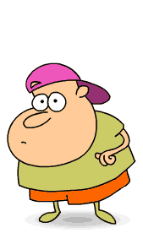

Image Formats – GIF Features[3]
Interlacing
  It is a mechanism that makes images appear faster on-screen
    First pass has pixel rows 1, 9, 17, etc (every eighth row)
    Second pass has rows 5, 13, 21, etc. (every remaining fourth row)
    Third pass has rows 3, 7, 11, 15, etc. (every remaining odd row)
    Fourth pass has rows 2, 4, 6, etc. (all the even-numbered rows)
Animation
  Allows timed display of images in sequence, giving the effect of animation
11-Jan-07
Multimedia Computing (EA C473)

Slide 11
Image Formats – GIF87a vs GIF89a [4]
GIF87a
  Supports LZW Compression
  Interlacing
  Limited to 256 colors
  Multiple image storage
GIF89a
  All the features in GIF87a
  Delay times, image replacement parameters
  Back ground transparency
11-Jan-07
Multimedia Computing (EA C473)

Slide 12
Image Formats – GIF87a [5]
GIF Signature
Screen Descriptor
GIF 87a file format
Global Color Map
Image Descriptor
Local color map
Repeated n times
Raster Area
GIF Terminator
11-Jan-07
Multimedia Computing (EA C473)

Slide 13
Image Formats – GIF87a [6]
7 6 5 4 3 2 1 0
1
2
Screen Width
GIF Screen Descriptor
3
4
Screen Height
5
m=1 => Global color map follows
m
cr
0
pixel
cr+1 => #bits of color resolution
6
pixel + 1 => Global color map follows
Back Ground
0 0 0 0 0 0 0 0
7
Byte #
11-Jan-07
Multimedia Computing (EA C473)

Slide 14
Image Formats – GIF87a [7]
R intensity
G intensity
GIF Color Map
B intensity
R intensity
G intensity
.
.
.
11-Jan-07
Multimedia Computing (EA C473)

Slide 15
Image Formats – GIF87a [8]
7 6 5 4 3 2 1 0
0 0 1 0 1 1 0 0
1
Image Separator Character
2
3
Start of image in pixels from left side of the screen
Image Left
4
5
Start of image in pixels from top of the screen
Image Right
Image Width
6
7
Width of the image in pixels
8
9
Image height
Height of the image in pixels
m=0 Use Global Color map, ignore pixel
m=1 Local color map follows, use pixel
i= 0/1 image in sequential / interlaced order
pixel+1 #bits per pixel for this image
m
i
0
0
0
pixel
10
GIF Image Descriptor
11-Jan-07
Multimedia Computing (EA C473)

Slide 16
Image Formats – GIF [8]
When to use GIF?
  Images with areas of flat color, such as logos, line art, icons & cartoon-like illustrations
  Not much suited for photographic images
  Suited for adding simple animation
  Whenever transparency in image is required (even though PNG supports this feature, not all web browsers supports it)
11-Jan-07
Multimedia Computing (EA C473)

Slide 17
Image Formats – PNG
Portable Network Graphics
Developed in early 1995 as nonproprietary alternative to GIF
Three advantages over GIF
  Alpha channels
  Gamma correction
  2D Interlacing
Supports 48 bit color
Supports lossless compression
Does not support multiple image format/ animation like GIF
11-Jan-07
Multimedia Computing (EA C473)

Slide 18
Image Formats – JPEG
Widely used image format
Compression standard used is JPEG, Joint Photographic Experts Group
Created by the working group, JPEG, of ISO
Compression is lossy
For a Quality factor 75%, JPEG achieves image size around 6% of original size
11-Jan-07
Multimedia Computing (EA C473)

Slide 19
Image Formats – Other Formats
TIFF (Tagged Image File Format)
EXIF (Exchange Image File)
PS & PDF
WMF (Windows Meta File)
BMP (BitMaP)
PAINT & PICT (MacPaint & MacDraw programs in Mac system)
11-Jan-07
Multimedia Computing (EA C473)

Slide 20
Reference
Chapter 3 of T1
Chapter 4 of T2
11-Jan-07
Multimedia Computing (EA C473)

